Slide 1
Rugged Board
PWM
https://community.ruggedboard.com

Slide 2

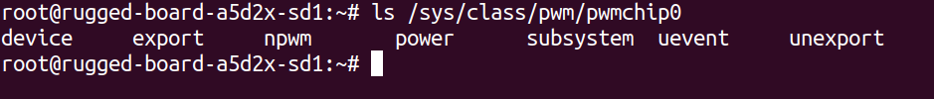
RB-PWM
PWM in Rugged Board through sysfs
Using pwmchip interface
pwmchip0 is used for PWM interface
List of files in pwmchip0
Note: npwm gives number of pwm channels

Slide 3
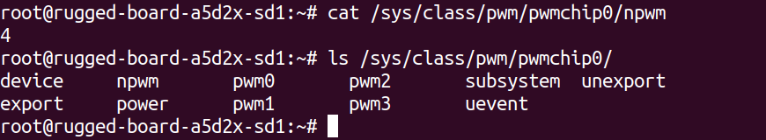
RB-PWM
echo x > /sys/class/pwm/pwmchip0/export
where x takes value 0,1,2,3
pwm1 is present in mikro bus we are going to use this for our experiment

Slide 4
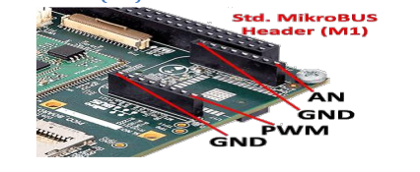
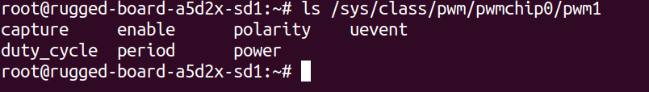
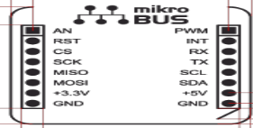
RB-PWM
pwm1
enable
period
duty_cycle

Slide 5
RB-PWM
Step1: export pwm1
# cd /sys/class/pwm/pwmchip0/
# echo 1 > export
Step2: set period for pwm1
# echo 100 > /sys/class/pwm/pwmchip0/pwm1/period
Step3: set duty_cycle for pwm1
# echo 0.25 > /sys/class/pwm/pwmchip0/pwm1/duty_cycle
Step4: enable pwm1
# echo 1 > /sys/class/pwm/pwmchip0/pwm1/enable

Slide 6
RB-GPIO
C program to change the brightness of the LED

Slide 7
Open Discussions

Slide 8





Connect-us
Developer
Wiki

Slide 9
